Slide 1
Boot TI Keystone II Linux Kernel
(RAM File-system)
Vincent Han
Mar, 2014

Slide 2
Agenda
Environment Settings
Boot Linux Kernel (RAM File-system)

Slide 3
Environment Settings
We use the XTCIEVMK2X EVM as the example
Before run the Linux kernel, please make sure the following points are done:
  Installed MSCDK on PC
  Installed USB to COM driver on PC
  Burnt U-Boot on EVM SPI Flash (should be compatible with kernel)
  Change the BMC to the “ARM SPI Boot” mode
  Insert and connect mini-USB cable on EVM USB com port
  Insert and connect Ethernet cable on ENET0 (RJ45) port
Notes:
3

Slide 4
Environment Settings
Make sure the U-boot environment variables’ settings are the actual Linux kernel related files you want to use
We use the prebuilt images and files in MCSDK as the example, the prebuilt files are in path of ${MCSDK_LINUX_INSTALL_PATH}/images
We can use the following command to check these variables:
  env print
For RAM file system, we should choose the correct boot method:
  setenv boot ‘ramfs’
We can use such command to modify other variables, e.g.:
  setenv ${COMMAND_NAME} ‘${VALUE}’
Notes:
4

Slide 5
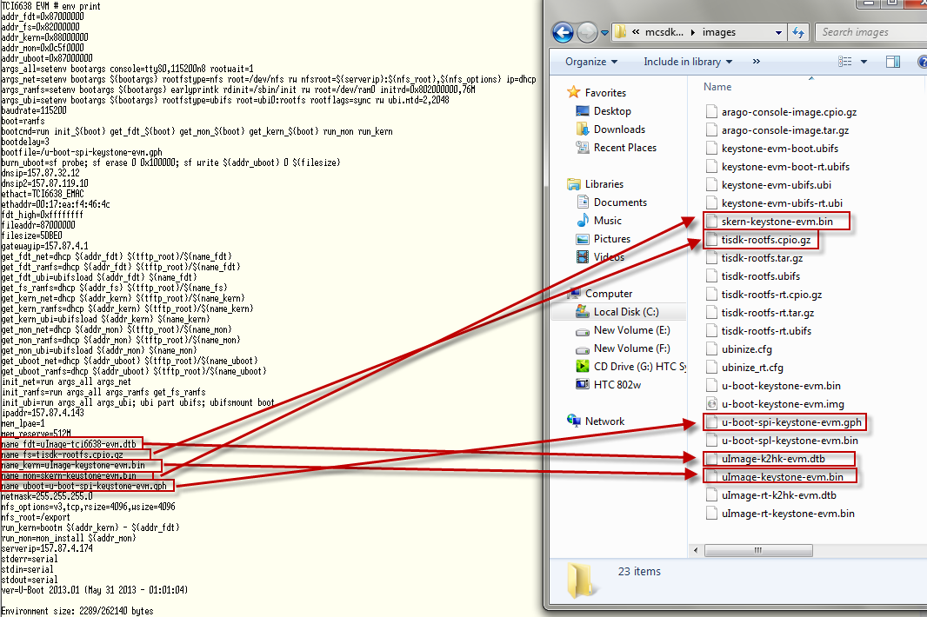
Environment Settings
Notes:
5

Slide 6
Environment Settings
Please note the value of “args_ramfs”
  Default value is “args_ramfs=setenv bootargs ${bootargs} earlyprintk rdinit=/sbin/init rw root=/dev/ram0 initrd=0x802000000,9M”
  “9M” here means the file system size ceiling for Mbyte
  Please modify this value to the actual size of the file system
We can use the following command to set the server IP:
  setenv serverip ‘XXX.XXX.XXX.XXX’
Then use the following command to save back to NAND:
  saveevn
Notes:
6

Slide 7
Agenda
Environment Settings
Boot Linux Kernel (RAM File-system)

Slide 8
Boot Linux Kernel (RAM File-system)
Before you boot Linux kernel, please make sure the Ethernet you connected with EVM has DHCP, or you need to set the IP address manually
If you configured the environment variables correctly, U-Boot will boot Linux Kernel automatically by default.
Please note when using RAM file-system, Linux Kernel, Boot Monitor and DTB files will be download through Ethernet during every boot time.
For more information, please refer operation guide on deyisupport:
http://www.deyisupport.com/question_answer/dsp_arm/c6000_multicore/f/53/t/23812.aspx
Notes:
8

Slide 9
Thank You!

